Slide 1

Unlocking Customer Behavior: A Deep Dive into Term Deposit Subscriptions
This presentation provides key insights from a comprehensive data analysis aimed at understanding and predicting customer subscription behavior for term deposits. We'll explore dataset characteristics, customer demographics, marketing campaign patterns, and crucial correlations that lay the groundwork for predictive modeling.

Slide 2
Agenda
Presentation Roadmap
01
02
03
Dataset Overview & Quality
Data Characteristics & Outliers
Customer Demographics
Profiling our target audience for tailored strategies.
Understanding the foundation of our analysis.
Exploring the raw data and refining its integrity.
04
05
Marketing Campaign Patterns
Key Correlations & Processing Success
Identifying successful engagement strategies.
Unveiling relationships and preparing data for modeling.

Slide 3


Data Foundation
Dataset Overview & Quality
Our analysis is built on a robust dataset of 41,188 records, each containing 21 distinct features. This rich data source provides a comprehensive view of customer interactions and characteristics related to term deposit subscriptions.
Crucially, the dataset exhibits no missing values across all columns, ensuring high data integrity and reliability for our downstream analysis and model development.
This analysis reveals critical behavioral and demographic patterns in our bank marketing data, empowering us to optimize term deposit campaigns for maximum impact. By focusing on proven predictors, we can significantly enhance conversion rates and drive measurable growth.
Our objective was clear: identify what drives term deposit subscriptions. The insights gained allow us to move from generalized outreach to a more strategic, data-informed approach, directly influencing campaign effectiveness and ROI.
Clean Data, Clear Insights
The absence of missing values significantly reduces preprocessing effort and enhances confidence in our analytical findings.

Slide 4

Understanding Our Data Landscape
Our dataset comprises over 45,000 records, providing a rich foundation for understanding customer behavior in direct marketing. The key target is whether a client subscribed to a term deposit (binary: Yes/No).
Key Attribute Categories
Demographics: Age, job, marital status, education.
Contact Details: Type, duration, month of last contact.
Historical Interaction: Previous campaign outcomes, number of
contacts.
Economic Indicators: Employment variation rate, consumer price index, euribor rate.

Slide 5








Data Insights
Key Data Characteristics
Age Distribution
Campaign Contacts
Customers range from 17-98 years, with a median age of 38. This wide range necessitates careful segmentation.
Most customers were contacted 1-3 times, with outliers up to 56 contacts.
Previous Outcomes
Call Duration
A significant majority had no previous marketing contact, indicating new acquisition focus.
Duration varies significantly (0-4,918 seconds), highlighting diverse interaction lengths.
Understanding these distributions is critical for segmenting customers and tailoring marketing efforts effectively.

Slide 6

Data Refinement
Outlier Analysis & Handling
Initial Outliers Detected
Age: 469 records identified as age outliers.
Duration: 2,963 records with unusually long or short call durations.
Campaign: 2,406 instances of extreme contact frequencies.
Previous Contacts: 5,625 records showing abnormal past interactions.
Consumer Confidence Index: 447 records on this economic indicator.
Post-cleaning: All detected outliers were successfully handled using a median replacement strategy, preserving data integrity while mitigating their impact.

Slide 7

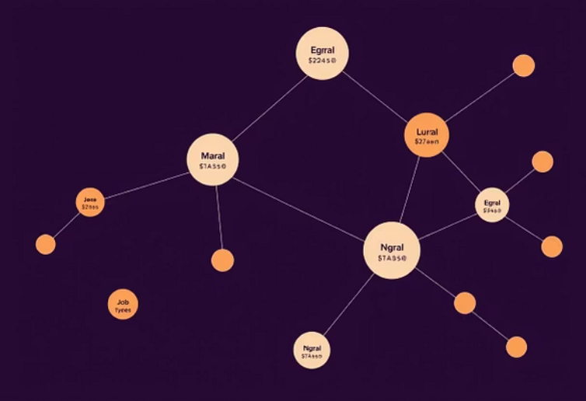





Audience Profile
Key Customer Demographics
Marital Status
Education Levels
Married customers represent the largest segment, suggesting a key demographic for targeted campaigns.
University degree holders are prominently represented, indicating an opportunity for more nuanced communication.
Common Job Types
Contact Method Preference
Administrative roles and blue-collar workers are common, providing insights for messaging and channel selection.
Cellular contact appears more prevalent than traditional telephone, informing optimal outreach channels.

Slide 8

Campaign Effectiveness
Marketing Campaign Patterns
Seasonal Trends
Duration Impact
May consistently shows the highest campaign activity, aligning with potential seasonal purchasing behaviors.
Longer call durations may correlate with higher subscription outcomes, suggesting the importance of in-depth conversations.
Weekly Patterns
Previous Outcomes
Specific days of the week exhibit higher contact rates, allowing for optimized scheduling.
Past campaign success significantly influences current subscription likelihood, emphasizing the value of historical data.
These patterns enable us to refine campaign timing, content, and targeting for maximum impact.

Slide 9

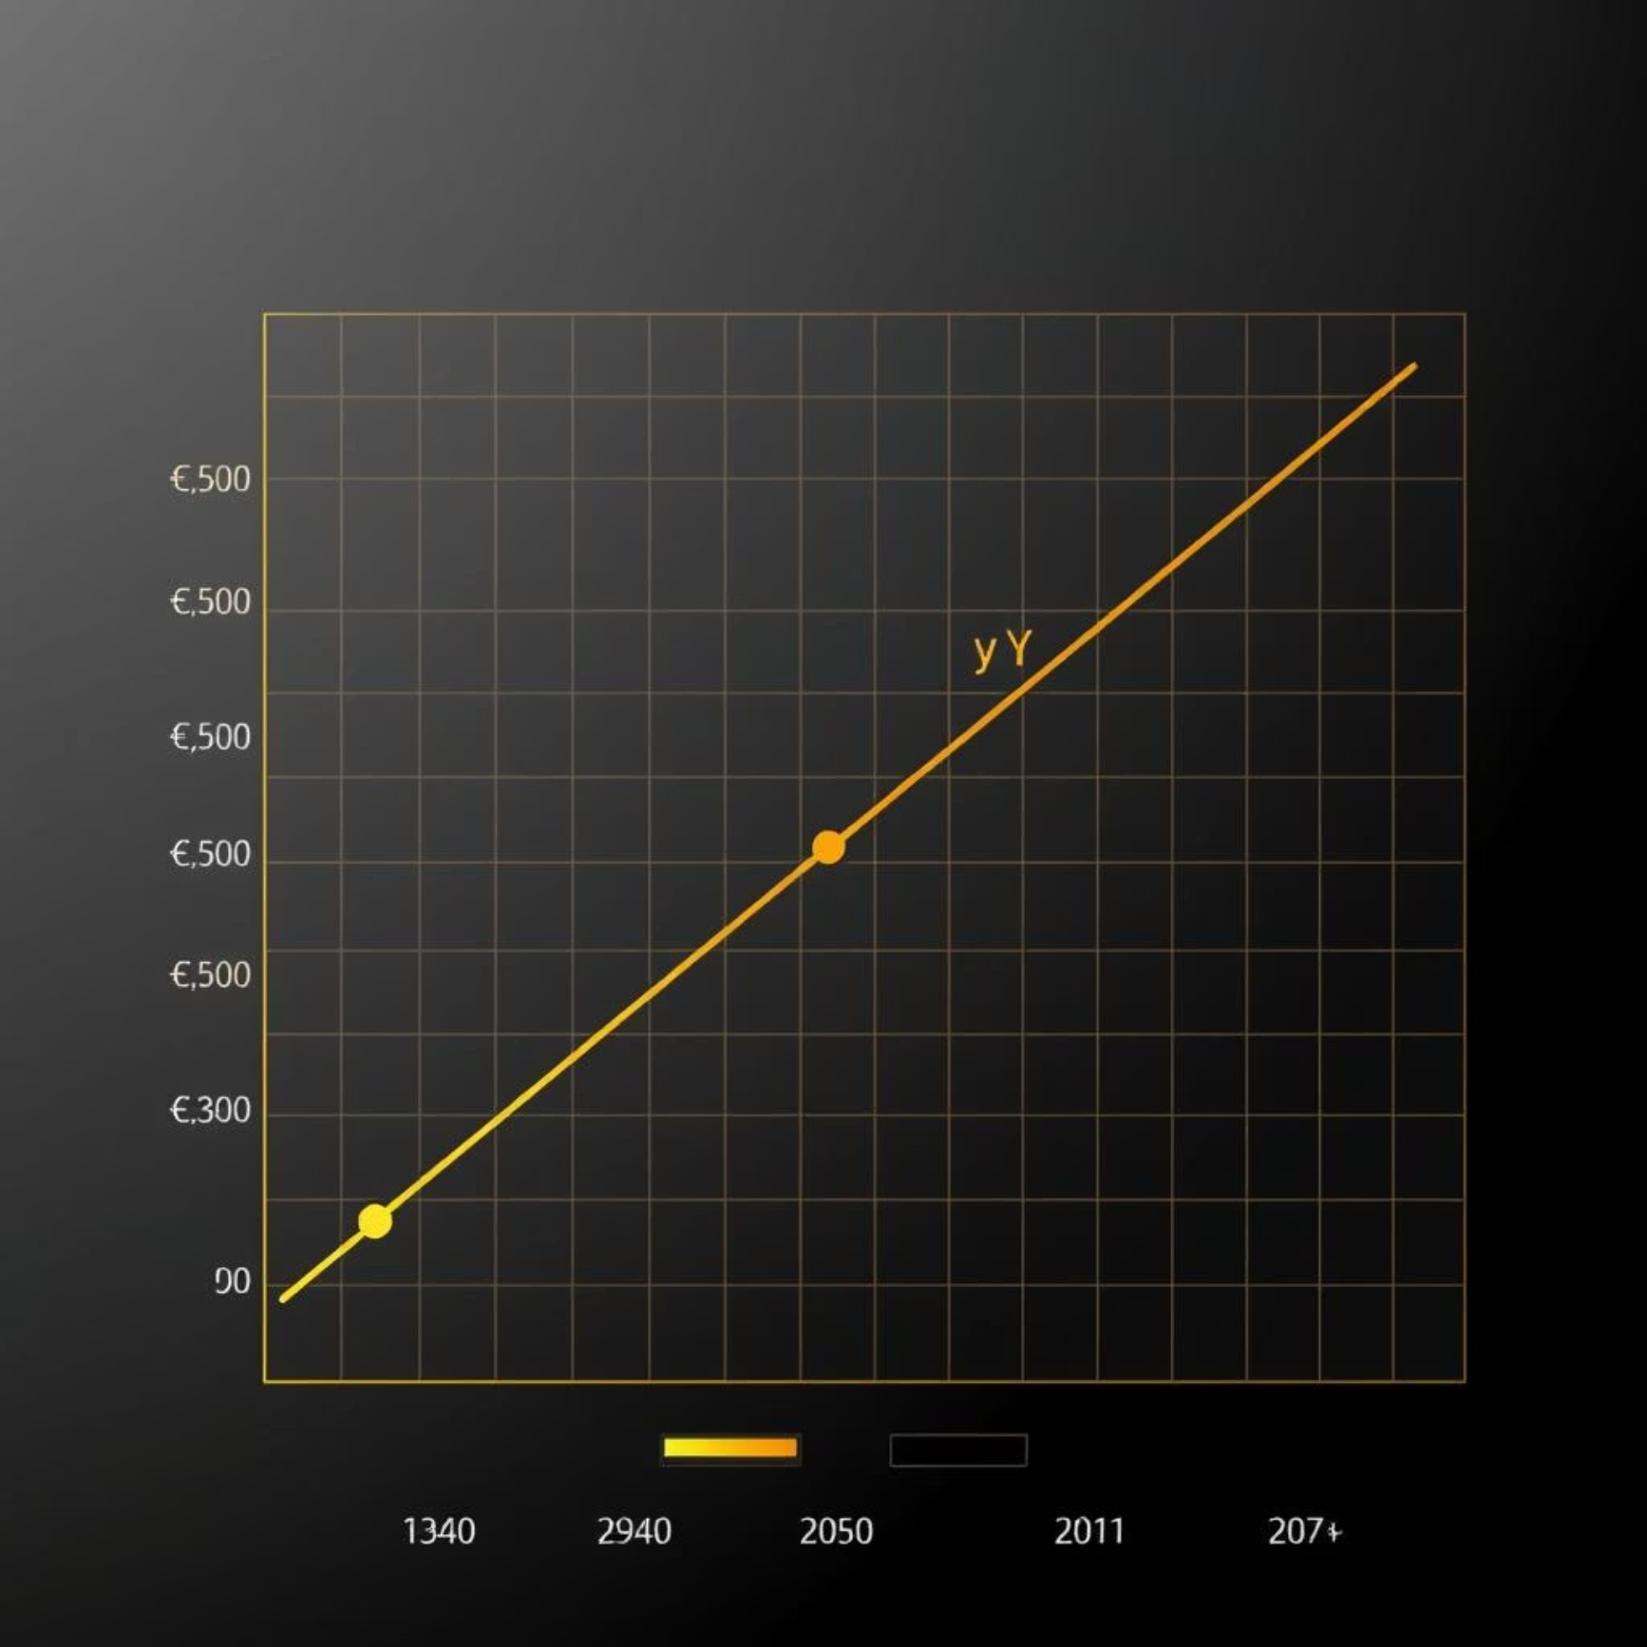
Visual Evidence: Data in Action
Subscription Imbalance: A bar chart clearly shows the stark difference between subscribers and non-subscribers, confirming our target imbalance challenge.
Predictive Power of Duration: A heatmap reveals a strong correlation between call duration and subscription, reinforcing its importance.
Visual analysis of our data not only confirms our findings but also provides intuitive understanding of the underlying patterns.

Slide 10
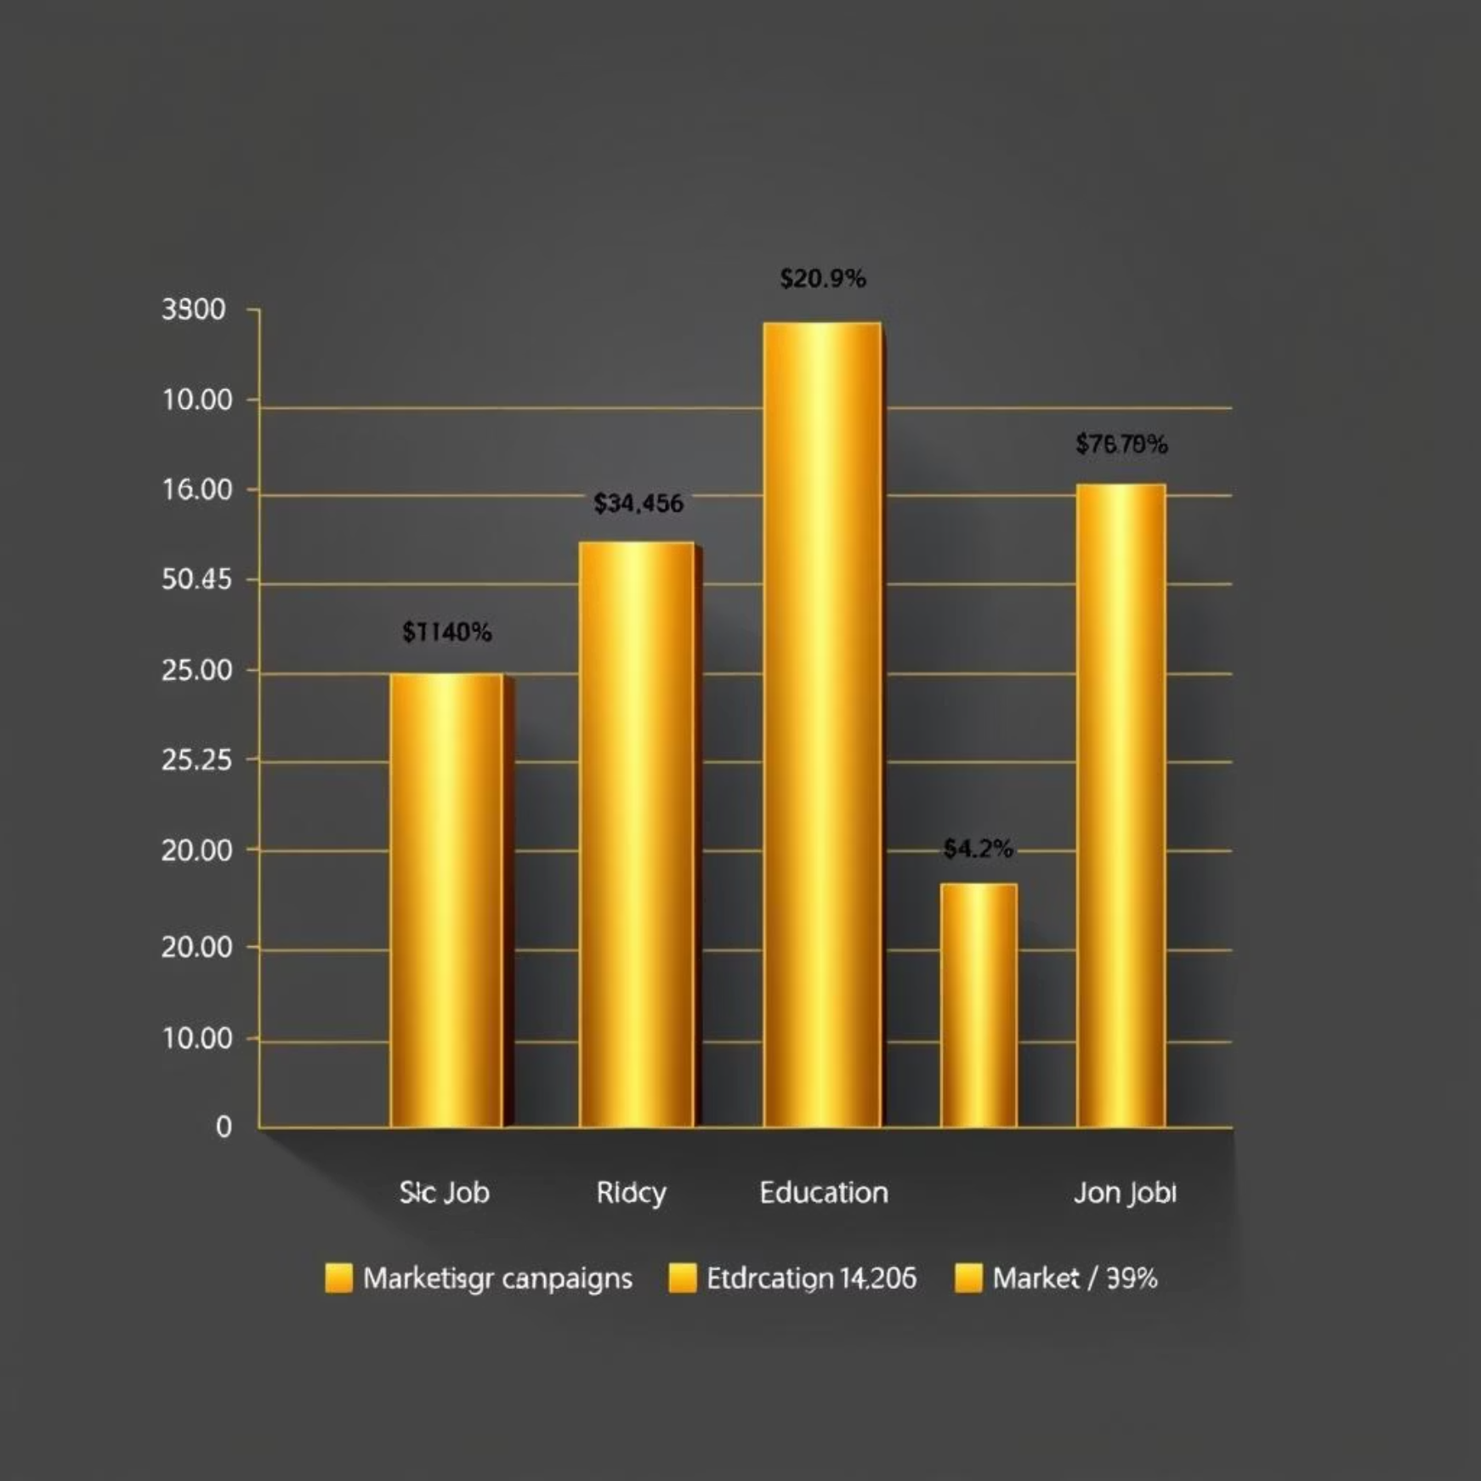
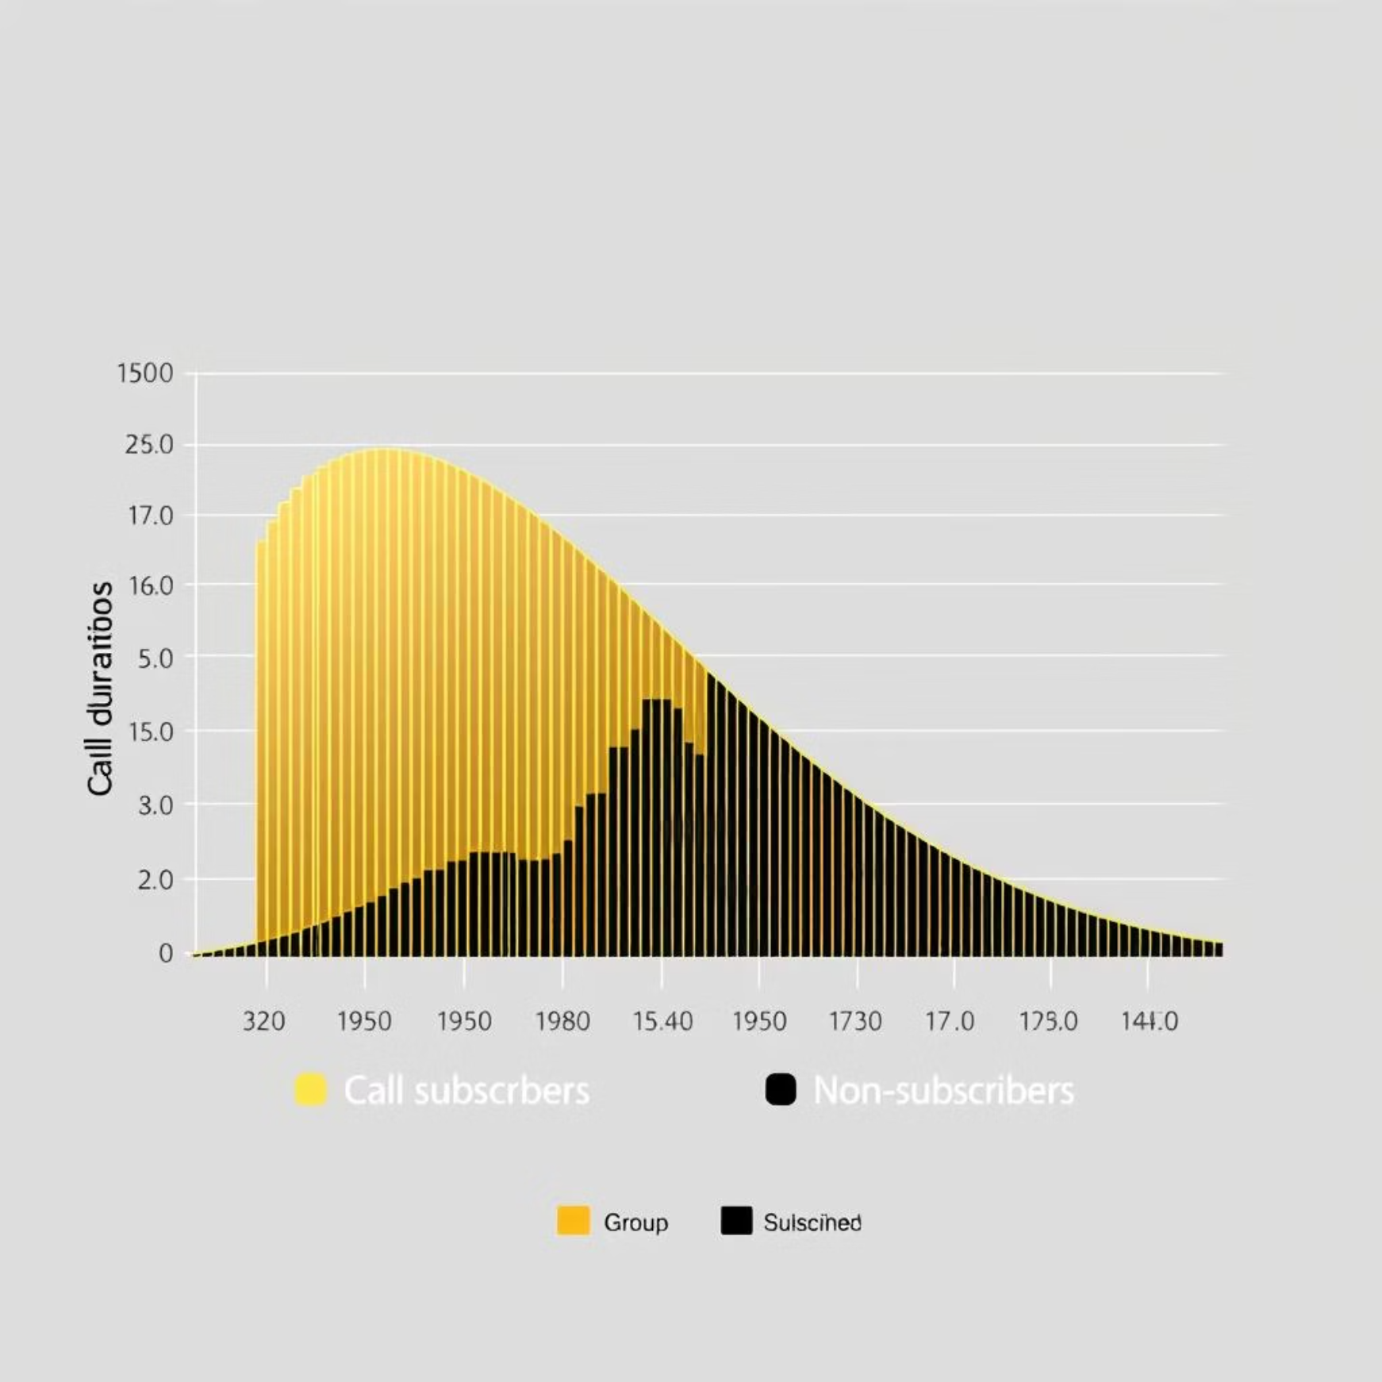
Visual Evidence: Deeper Dive into Customer Segments
Demographic and Seasonal Trends: Stacked bar plots vividly illustrate how subscription rates vary by job, education level, and the month of contact, pinpointing high-potential segments and periods.
Call Length Distribution: Box plots clearly differentiate the distribution of call durations for subscribers versus non-subscribers, underlining that successful conversions often involve longer, more meaningful engagements.
These visuals highlight actionable segments and critical interaction points, guiding targeted campaign design.

Slide 11

Interconnected Data
Correlation Insights
Strong Correlations
Economic indicators like the employment rate and Euribor rate show a very high correlation of 0.97 with each other. This suggests macroeconomic conditions are a significant factor in subscription behavior.
Weak Age-Duration Correlation
Interestingly, there is a minimal relationship between customer age and call duration, with a correlation of just 0.004. This indicates that call length is not dependent on the customer's age.
Understanding these correlations helps us prioritize features for predictive modeling and identify underlying drivers of subscription.

Slide 12



Preparation for Prediction
Data Processing Success
Our data processing pipeline successfully transformed raw data into a machine learning-ready format, ensuring optimal performance for predictive models.
Clean Dataset
Transformed raw data into a pristine, analysis-ready format, removing noise and inconsistencies.
Binning Strategy
Created meaningful age groups and duration bins to enhance interpretability and model performance.
Feature Engineering
Added categorical bins for continuous variables, improving model understanding and predictive power.

Slide 13



Actionable Recommendations: Maximizing Conversion
Targeted Engagement
Segmented Messaging
Train agents to extend conversations, especially with high-potential profiles.
Tailor campaigns for professionals, university-educated, students, and retirees.
Optimal Timing
Cellular Priority
Focus efforts on March, April, and September; scale back in low-yield months.
Increase investment in cellular outreach given its superior conversion rates.
Leverage History
Economic Alignment
Prioritize re-engaging clients with a history of positive responses.
Strategize campaigns during favorable economic conditions, such as lower euribor rates.

Slide 14

Conclusion: Towards Data-Driven Marketing Excellence
Our comprehensive analysis has revealed distinct patterns in customer behavior and campaign performance for term deposit subscriptions. These insights provide a clear roadmap for strategic optimization of our marketing efforts.
By aligning our strategies with these data-backed findings, the bank can achieve a significant improvement in conversion rates, leading to greater profitability and efficient resource allocation.

Slide 15

Next Steps
Key Takeaways & Future Outlook
Comprehensive Dataset: Robust foundation with no missing values.
What's Next?
This robust analytical foundation is now primed for the development and deployment of advanced machine learning models to accurately predict customer subscription behavior, enabling proactive and highly effective marketing interventions.
Refined Data: Outliers effectively handled, ensuring data quality.
Targeted Marketing: Demographics and campaign patterns inform optimized strategies.
Predictive Potential: Strong correlations provide valuable features for ML models.
To focus on the future, To focus on the key takeaway, To end more effectively & formally.

Slide 16


Next Steps & Call to Action
Ready to transform your marketing strategy?
Further Exploration
Schedule a Follow-Up
We can dive deeper into predictive modeling, refine segmentation
strategies, or explore specific campaign scenarios.
Let's discuss how these insights can be integrated into your
upcoming campaigns.
Contact me for a follow-up presentation or a deeper dive into predictive modeling results.

Slide 17
THANK YOU
GET IN TOUCH
Github : https://github.com/dhanuda26/Banking-Data-Analysis.git
LinkedIn : www.linkedin.com/in/dhanasekaran-mohanraj-da

